Slide 1

PA Dutch 101
Video 18: The Weather.
Es Wedder

Slide 2
es Wedder
When asking about the weather in PD, use the following phrase:
Wie iss es Wedder?

Slide 3
es Wedder
Die Sunn scheint – The sun is shining.
Es reggert. – It is raining.
Es schneet. – It is snowing.
Es dunnert. – It is thundering.
‘Sis windich. – It is windy
‘Sis schee. – It is nice out.
‘Sis schlecht. – It is nasty out.

Slide 4
es Wedder
When talking about temperature use:
‘Sis kalt. – It is cold.
‘Sis kiehl. – It is cool.
‘Sis warm. – It is warm.
‘Sis hees. – It is hot.
‘Sis 30 (Graad.) – It is 30 (degrees).

Slide 5
es Wedder
Here are few more weather words:
drieb – cloudy
darr, drucke – dry
suddlich – drizzling
newwlich – foggy
schmodich – humid
feicht – damp
eisich - icy

Slide 6

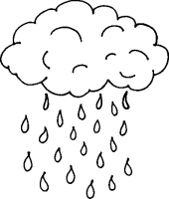

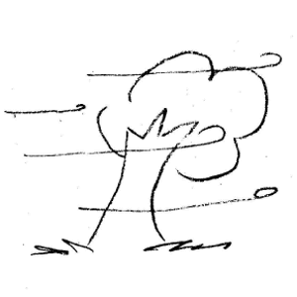
Iewing - Practice
Gettysburg - Monday | Philadelphia - Wednesday
85 | 40
Heidelberg, Germany - Friday | Los Angeles - Thursday
20 | 63

Slide 7
Iewing - Practice
Die Sunn scheint am Mundaag in Gettysburg. ‘Sis hees.
Es reggert am Mittwoch in Philadelphia. ‘Sis kiehl.
Es schneet am Freidaag in Heidelberg, Deitschland. ‘Sis kalt.
‘Sis windich am Dunnerschdaag in Los Angeles. ‘Sis warm.

Slide 8

Bis die naegschde Video,
Macht’s gut un schwetzt Deitsch!
E-Poscht schreiwe: busterpa@yahoo.com

